Slide 1

JFK and Toni Morrison
By Arta, Miron, and Mohammad

Slide 2
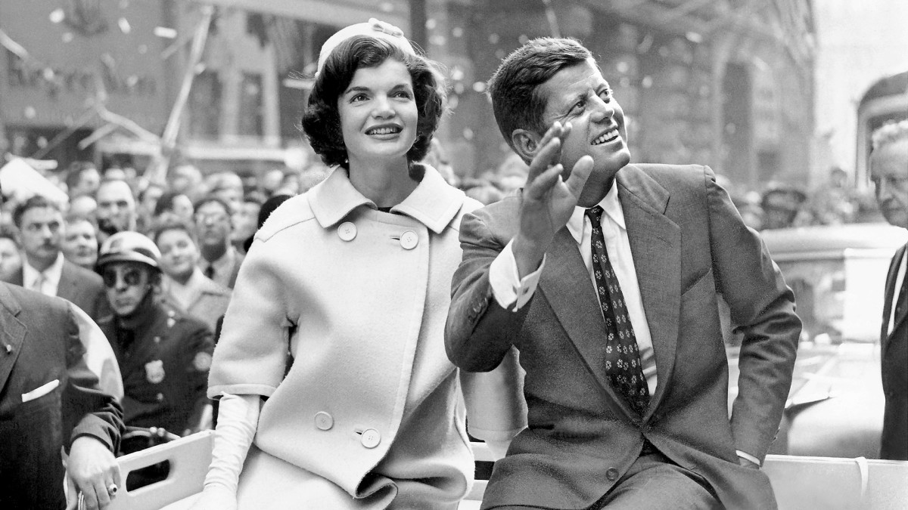
About JFK
John Fitzgerald Kennedy often called JFK and Jack, was the 35th President of the United States. He was in office from 1961 until his assassination in 1963. He was the youngest President elected to the office, at the age of 43.
He was born on May 29, 1917. He aged 46 until he was assassinated on November 22, 1963.

Slide 3

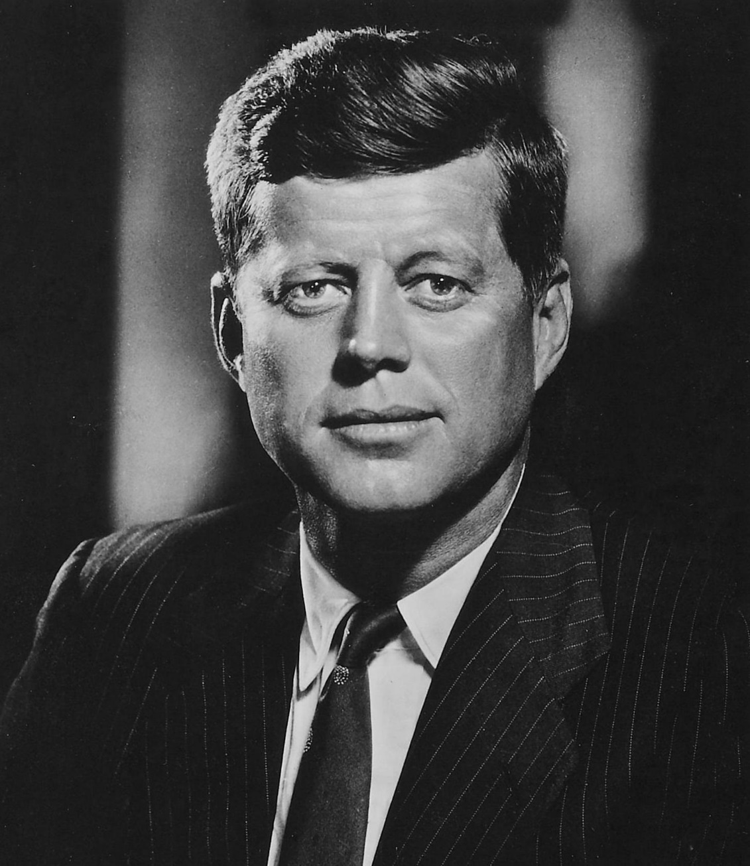
Events during his presidency included the Bay of Pigs Invasion, the Cuban Missile Crisis, the building of the Berlin Wall, the Space Race, the Civil Rights Movement, and early stages of the Vietnam War. He was the youngest President of the United States to die in office.

Slide 4
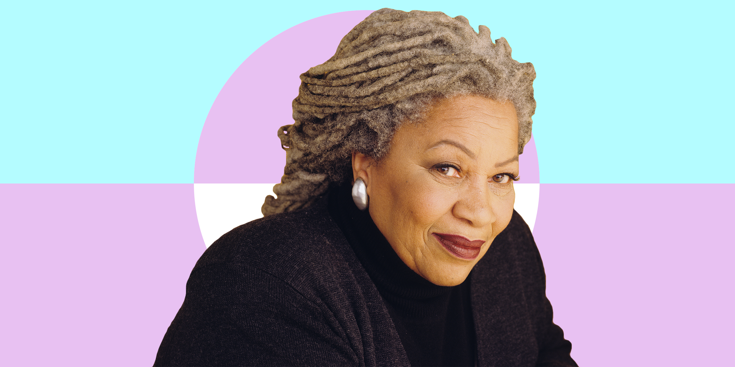
About Tony Morrison:
She was born in Chloe Ardelia Wofford on February 18, 1931 and at age of 88 died on August 5, 2019
Chloe Anthony Wofford Morrison , known as Toni Morrison, was an American novelist, essayist, book editor, and college professor. Her first novel, The Bluest Eye, was published in 1970.

Slide 5

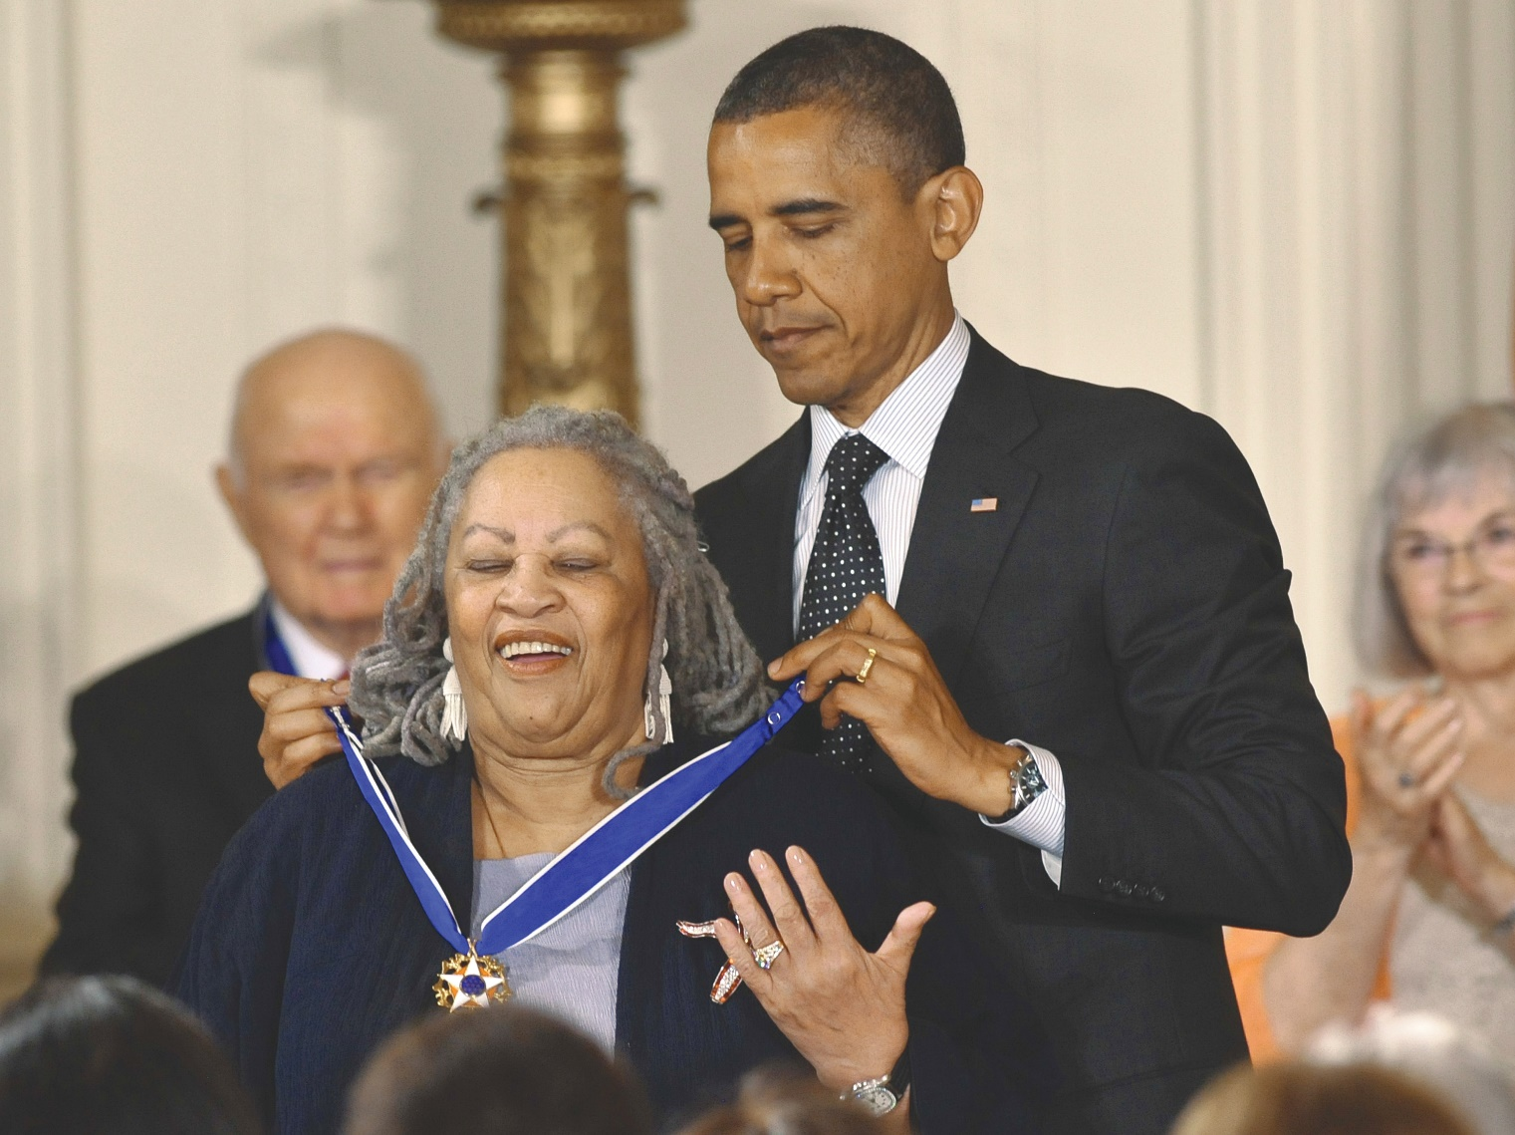
The critically acclaimed Song of Solomon (1977) brought her national attention and won the National Book Critics Circle Award. In 1988, Morrison won the Pulitzer Prize for Beloved (1987); she gained worldwide recognition when she was awarded the Nobel Prize in Literature in 1993.

